Slide 1
Ctutor – User Manual
A short video that demonstrate how to use Ctutor with prutor is on the link
https://youtu.be/IWDuHYxRy-g
Next slides show the step by step process to use Ctutor with Prutor

Slide 2
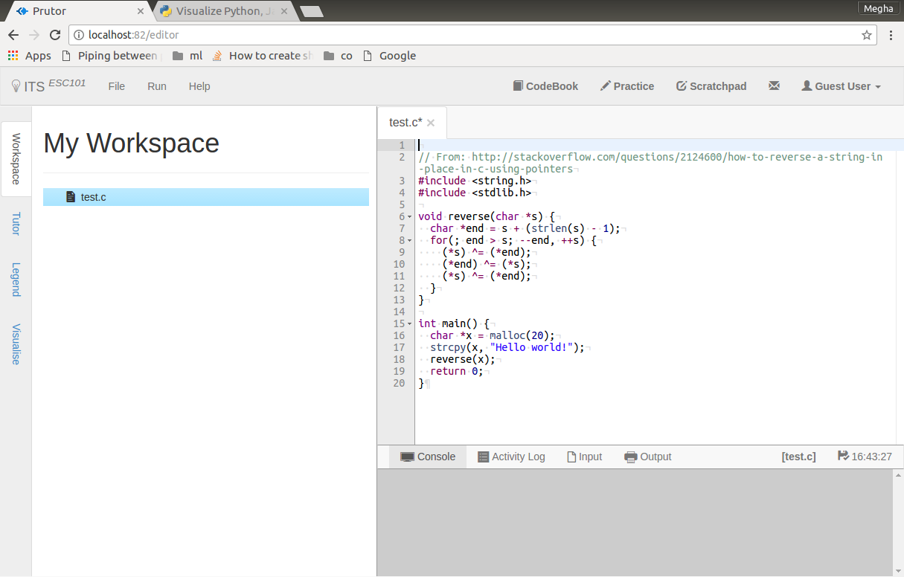
Open Prutor and write your code in editor

Slide 3
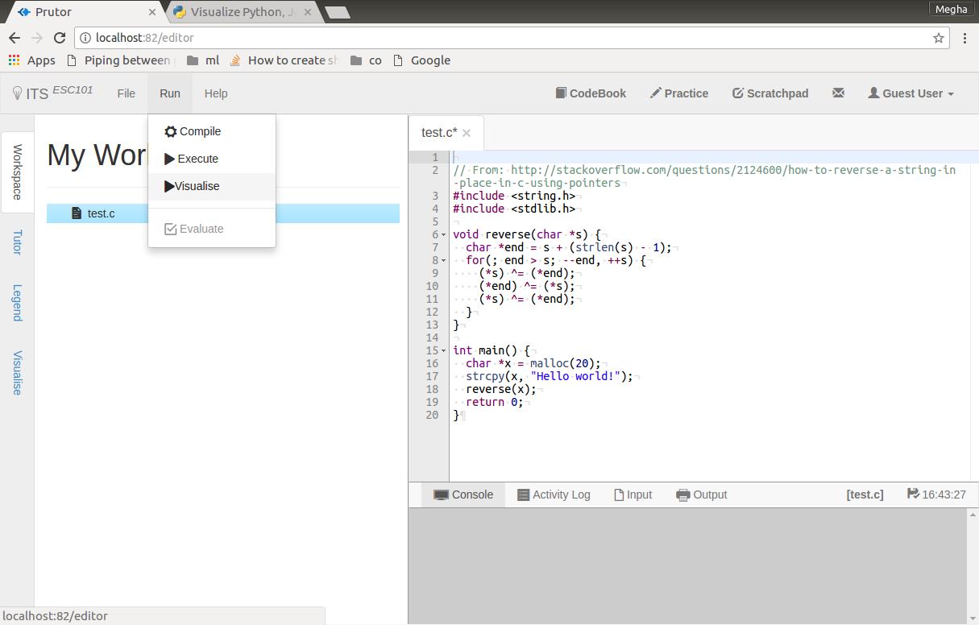
Go to Run -> Visualise.

Slide 4
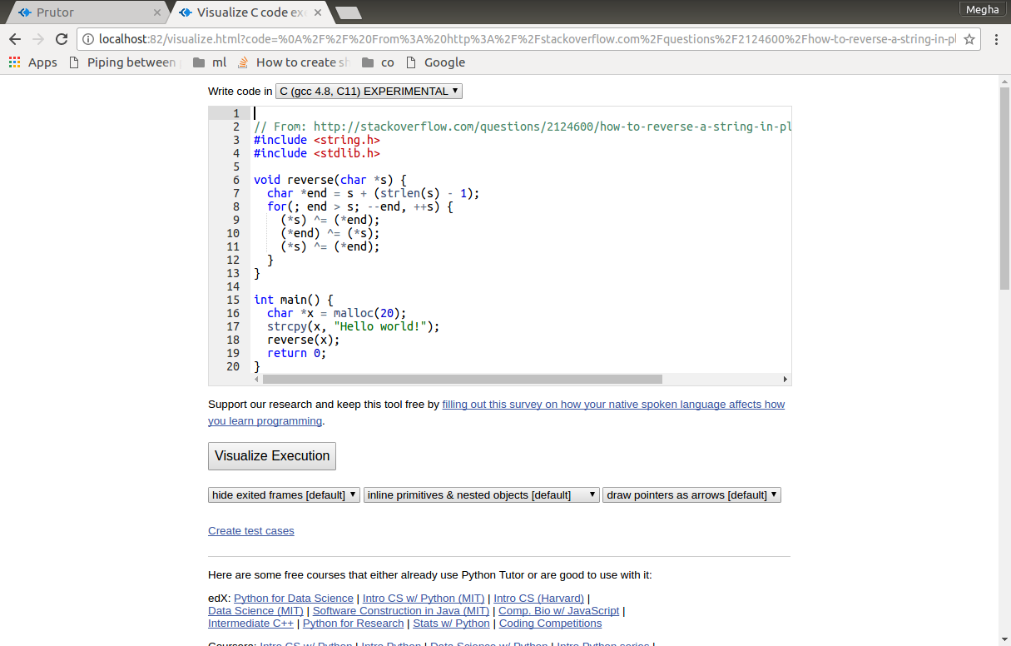
A window as shown will open up in new tab

Slide 5
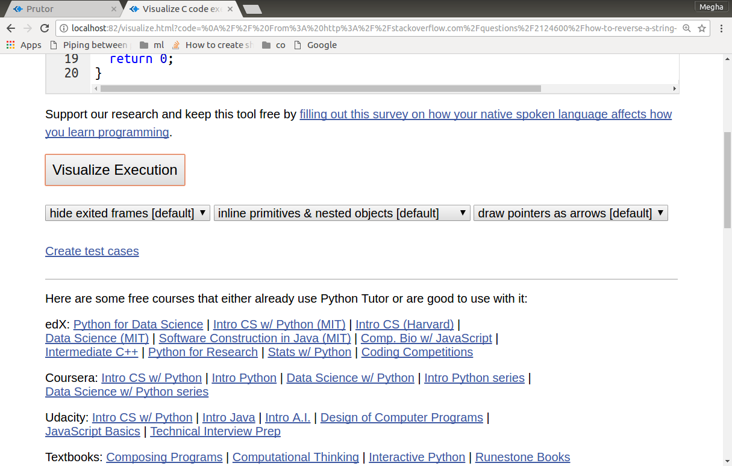
If you have no input features like scanf or getchar() just click on Visualize Execution button below oto visualise your code

Slide 6
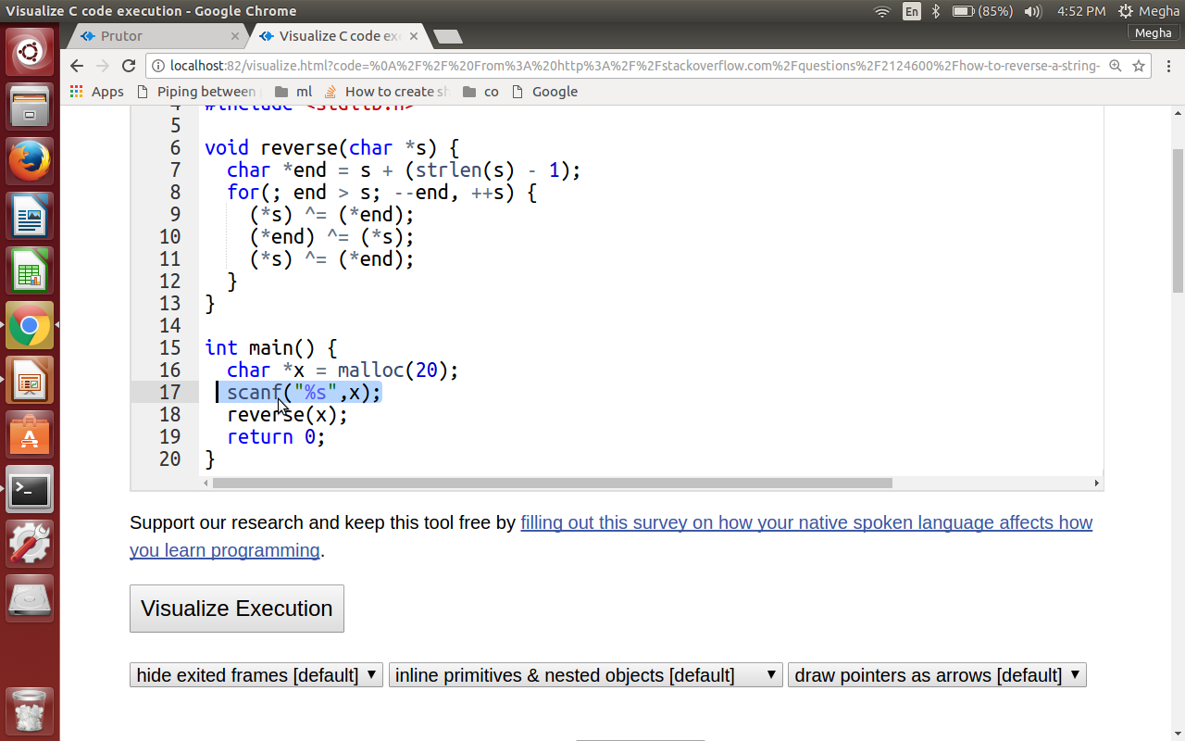
If you have userinput like scanf or getchar()

Slide 7
Click on “Create test cases”

Slide 8
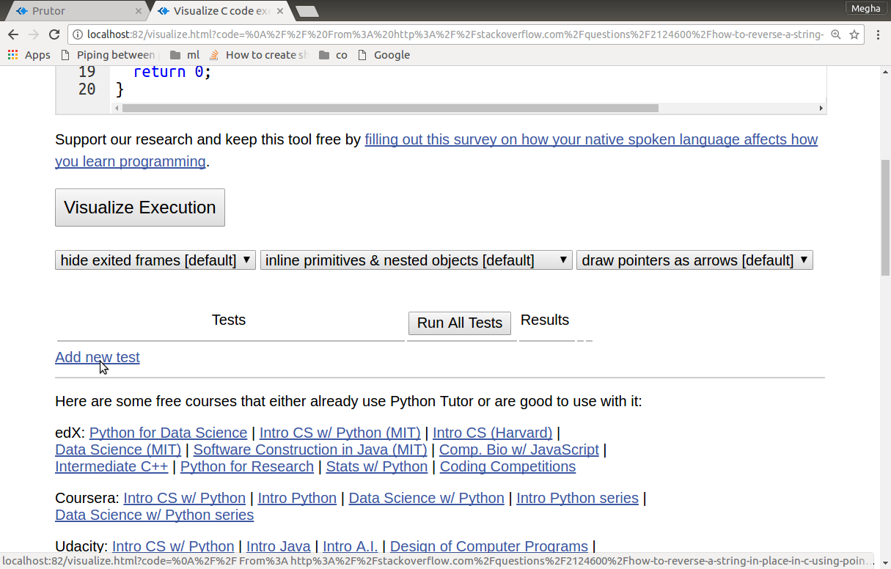
Click on “Add new test”

Slide 9
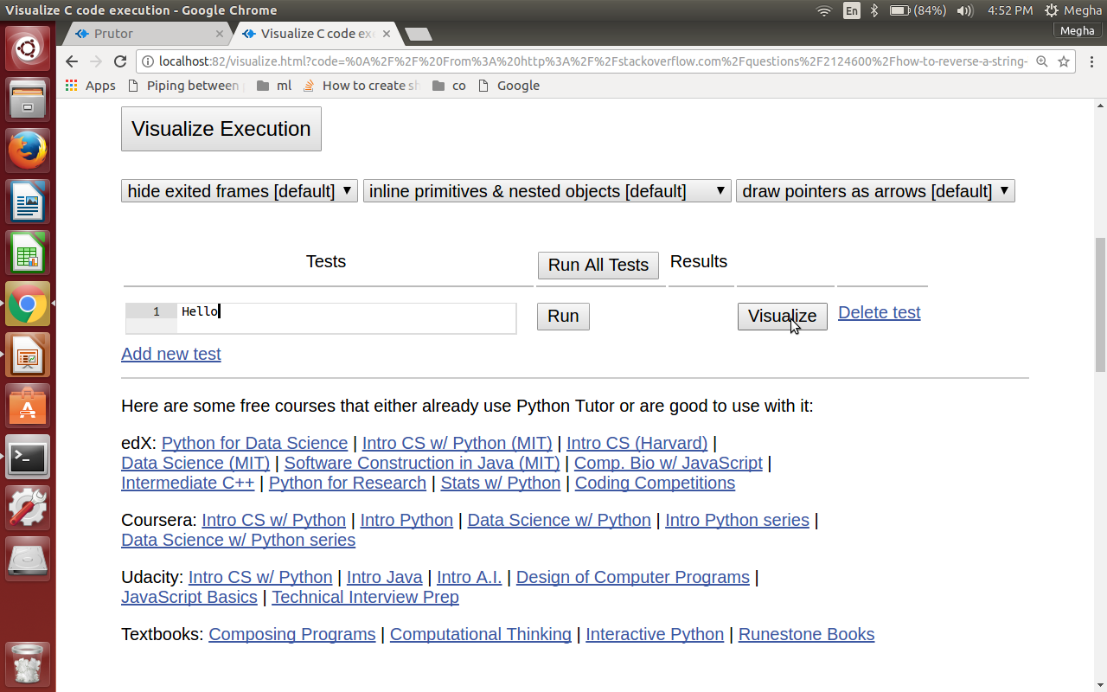
Insert your user input and click on “Visualize” button to visualise your code

Slide 10
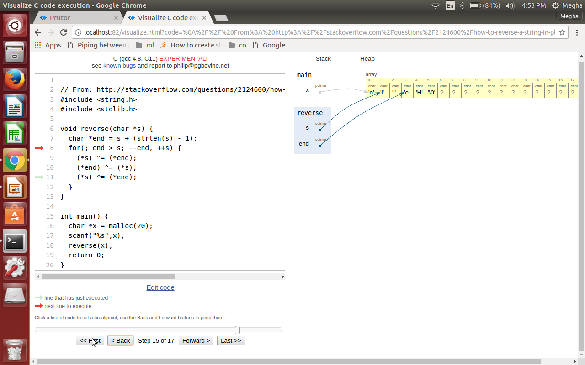
Visualisation will appear on right

Slide 11
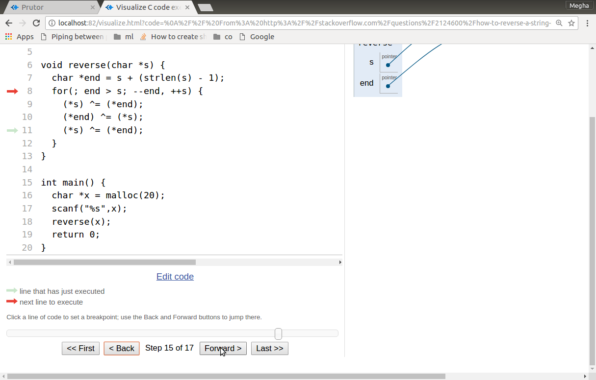
Using the slider below or forward and backward buttons to debug your code .The red arrow in left shows the step being currently executed. Hope you have great time Debugging your code :)

